Slide 1
CAB System
Team 9

Slide 2
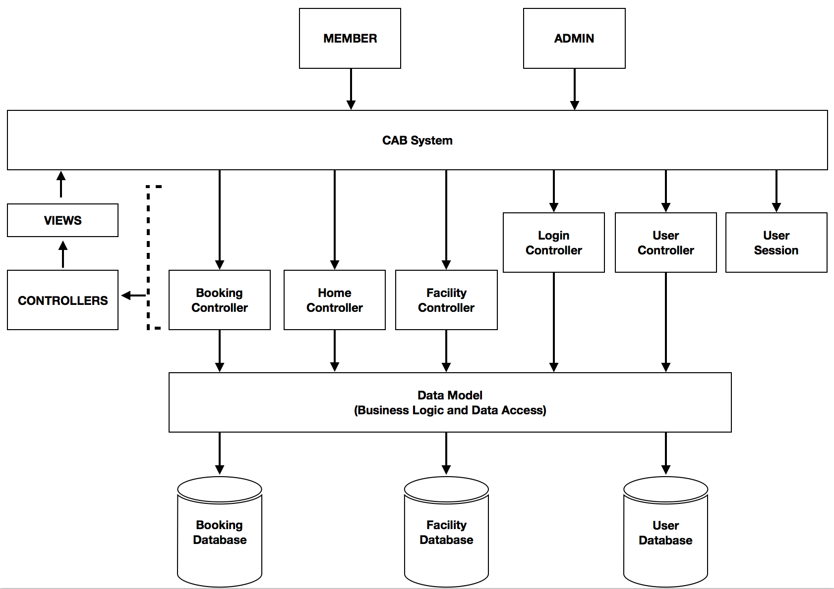
1. ARCHITECTURE

Slide 3
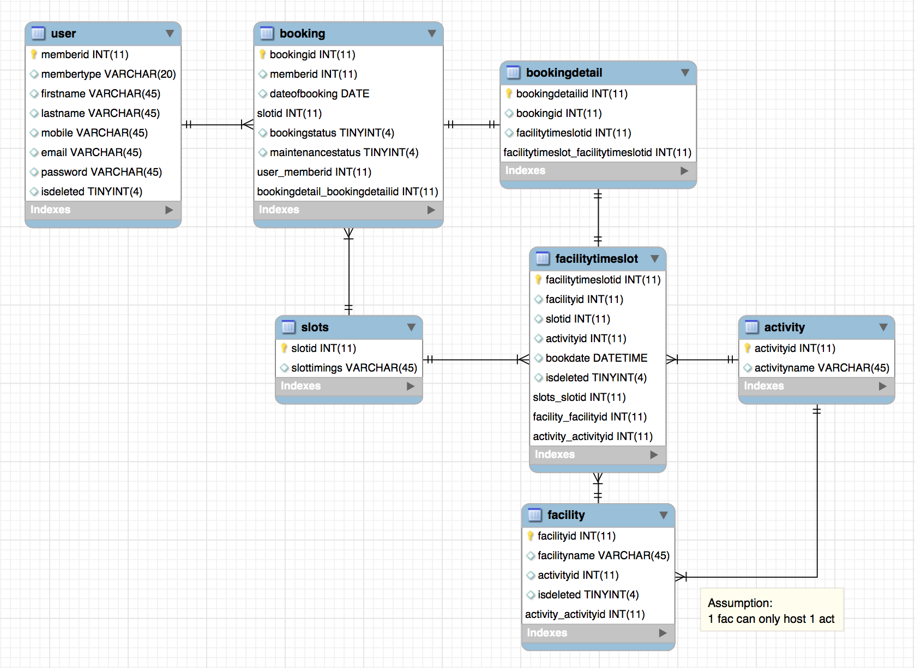
2. DATA MODEL

Slide 4
3. TEAM CONTRIBUTION
Chandrika | Search timeslots
Han Myint-Tun | manage booking, maintenance booking, search facility, UI design
Janelle Wang | manage facilities
Jason Lim | login
Liang Jingyu | manage users
Noel Noel Han | create project structure,create db design ,manage users, manage facilities, manage booking, search facility
Subash Machavel | search current booking, cancel booking

Slide 5
4. PROJECT EXPERIENCE
Challenge: Process
– Configurations – Timeboxes
Challenge: Testing
– Debugging – Hard to isolate issues
Challenge: Integration
– Iterating tests – Combining files

Slide 6
5. LESSONS LEARNT
Planning
– Changing database
– Backtracking
– Integration & Testing
Communication
– Standardisation – Expectations
Iterations
– Following procedures

Slide 7
Thanks!

